Slide 1
Attain Risk Management Process Training
November 2017
TRN_RSKM_PRC_2017v3.0

Slide 2
Risk Frameworks
ISACA
https://www.isaca.org/Knowledge-Center/Research/ResearchDeliverables/Pages/The-Risk-IT-Framework.aspx
Risk Management
ISO 31000
https://www.iso.org/files/live/sites/isoorg/files/archive/pdf/en/iso_31000_for_smes.pdf
DIACAP RMF
https://rmf.org/ for information security risk management
CMMI
http://www.software-quality-assurance.org/cmmi-risk-management.html#intro

Slide 3
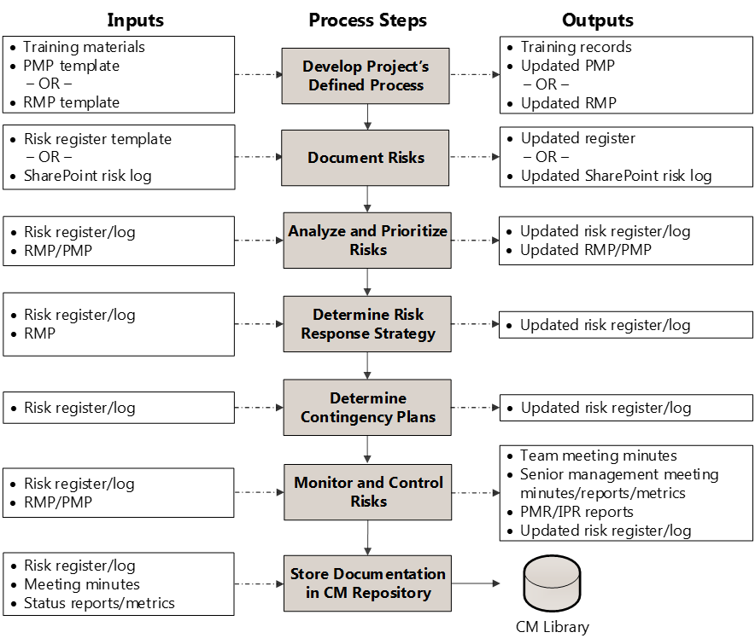
Attain Risk Management Process Flow

Slide 4
Continuous Risk Management
RM Process
Planning
Identify
Analyze
Prioritize
Mitigate and Contingent Plan
Execute
Evaluate
Document
Continuously identify new risks
Continuously analyze, re-score, and reprioritize risks
Continuously assess risks and response strategies – e.g., other events may occur which disrupt the viability of your response plan
Communicate

Slide 5
Roles and Responsibilities
Role | Responsibilities
Customer | Participates in risk escalation and approves contingency plans
Senior Management | Provides oversight and resources as needed Participates in risk escalation and contingency planning Participates in program management reviews (PMRs) and provides feedback on high risk items
Project Manager (PM) | Documents the risk management plan Documents risks and its contingency plans on the risk log Reviews the risk register and contingency plans during project team meetings Reports risk status to senior management and customer on a regular basis Ultimately responsible for the final decision regarding risk actions
Project Team | Works with PM to identify, analyze, monitor, and control all risk items during the project lifecycle Reports risk status to the PM on a regular basis as defined in the PMP
Attain Delivery Center of Excellence (DCoE) | Receives risk metrics from the PM Provide process resources and training Ensures adherence to the process

Slide 6


The Nature of Risk
Threat
Opportunity
Project Risk:
An uncertain event or condition that, if it occurs, has a positive or negative effect on a project objective
Why take a risk:
To gain a specific reward
Sometimes, you don’t have a choice

Slide 7
Risk Management
The systematic process of identifying, analyzing, and responding to project risks
It includes maximizing the probability and consequences of positive events and minimizing the probability and consequences of adverse events to project objectives
Benefits of Risk Management:
Minimize management by crisis
Minimize surprises and problems
Gain competitive advantage
Decrease overall project variances
Increase probability of success
Increase profitability
Focus on doing it right the first time
Prevent problems from occurring, or escalating
Responsibilities in Risk Management:
Project Manager
Initiate/lead RM process
Integrate RM into all PM processes
Provide direction to team on RM process and tools
Project Team
Understand and follow RM process
Execute RM strategies
Report status on RM process

Slide 8
Risk Management - Definitions
Risk is the effect of uncertainty on objectives; the effect matters!
An effect is a deviation from the expected.
Uncertainty is the state, even partial, of deficiency of information related to understanding or knowledge of an event, its consequence, or likelihood. Uncertainty in the example is from not fully understanding the consequences of a change.
An event is an occurrence or change of a particular set of circumstances and can have several causes.
A cause is that which gives rise to any action, phenomenon or condition. It is important not to mix up the cause and the event. A risk statement can contain multiple causes when applicable.
A consequence is the outcome of an event affecting objectives. This element of the risk statement is important because it highlights why one should care about the risk.
Likelihood is the chance of something happening; risk is a combination of potential events and consequences along with the associated likelihood of occurrence.
Impact – is the potential of the consequence.

Slide 9
Project Risk Management

Slide 10
Risk Management Throughout the Full Project Life Cycle
Risk Management
Initiate
Control
Plan
Execute
Close
RM begins as soon as the project is initiated and is ongoing through closeout
Project Planning Processes
Risk Assessment and Response processes are performed:
At regular intervals (weekly, monthly) throughout the project life cycle
Every time a new baseline or plan is established
At major milestones or decision check points
Project Execution and Control Processes
Risk Monitoring and Control processes are performed:
Continuously throughout the project life cycle
During project status and reporting updates

Slide 11


Develop the Project’s Defined Process
Review Attain Risk Management Process, customer required processes, and any other statutory, regulatory, or other legal requirements.
Work with DCoE to complete the project specific process tailoring form
Document project-specific risk practices in Risk Management Plan (RMP) or project/service management plan, obtain plan approval, and store in CM repository
Identify training needs; create and implement training such as:
Risk management process and approach
Risk management analysis methodologies
Risk management tool instructions

Slide 12
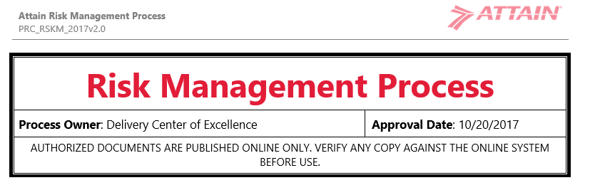
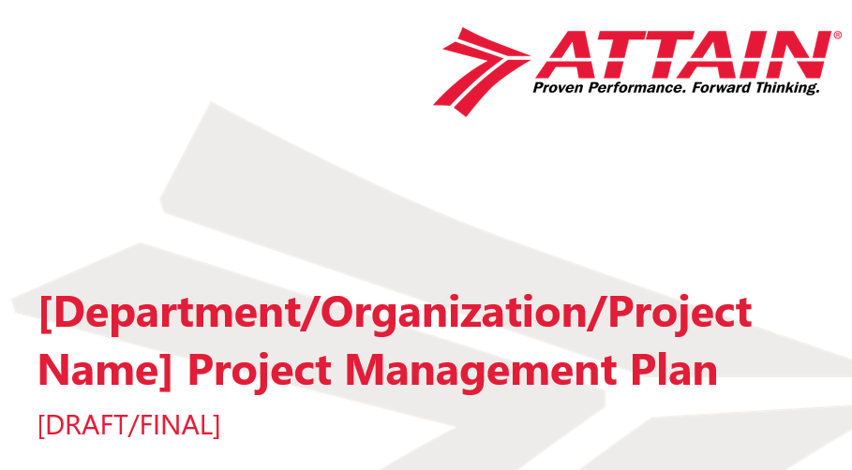
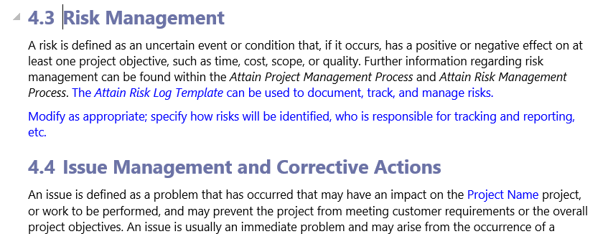
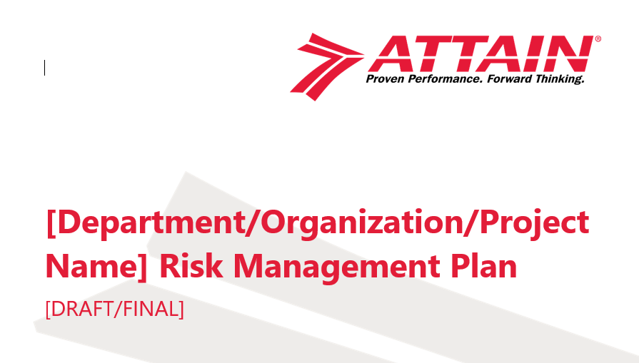
Develop the Project’s Defined Process

Slide 13
Identifying Risks
Ask “what could go wrong?”
Ask “what could happen?”
Ask “why could it happen?”
Ask “why do we care?”
Throughout the life of the project, ask “what did go wrong?”
Leverage experiences from prior projects

Slide 14
Identifying Risks
All team members are responsible for identifying risks, but it is the PM’s responsibility to foster a team environment that welcomes, encourages, and enforces timely risk identification and communication
Do not ignore warning signs – inform the PM immediately and update the risk log no matter how insignificant the risk appears at the time
Escalate potential risks early!
Risks can be identified during formal risk reviews with the team, ad hoc in a hallway, or even individually

Slide 15
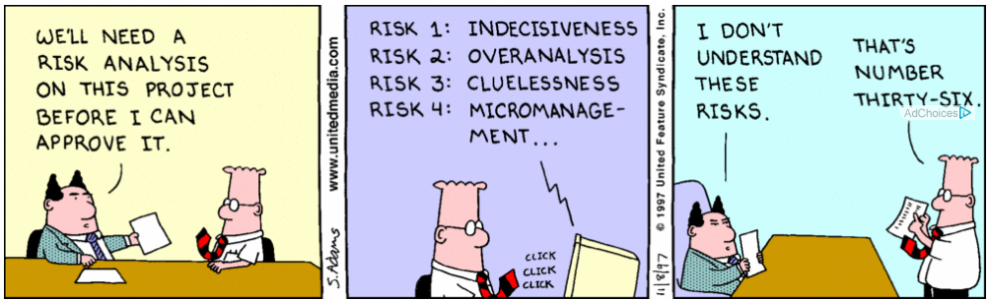

Writing Good Risk Statements
ISACA:
https://www.isaca.org/Journal/archives/2014/Volume-3/Pages/Writing-Good-Risk-Statements.aspx
https://www.isaca.org/Journal/archives/2014/Volume-3/Documents/Writing-Good-Risk-Statements_joa_Eng_0514.pdf

Slide 16
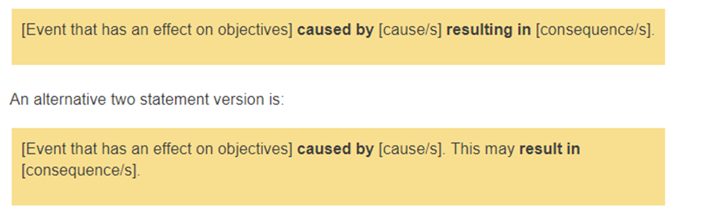
Documenting Risks
The effectiveness of the entire RM process is only as good as the quality and specificity of the risk event statements
Two recommended general formats:
“_____ may occur during _____, thereby causing an impact to _____.”
“If _____ occurs, then an impact to _____ will occur.”
Additional formats (ISACA):

Slide 17


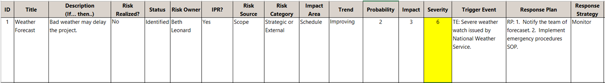
Document Risks
Risks may be identified by internal or external stakeholders
DOCUMENT and track risks in a comprehensive list (e.g., SharePoint, Excel – Attain’s Risk, Issue, and Decision Log Template)
Template contains instructions and drop down values which can be tailored

Slide 18
Documenting Risks Guidelines
Do not write as a question or a single word
Include no action items
Use complete sentences
Be as specific as possible
State the risk and the area of impact
Think about ability to quantify risk event impact
Remember it hasn’t happened yet! This is NOT an issue.

Slide 19
Risk Event Statement Examples
Poorly Written | Improved
The current overutilization of people in the organization | Software programmers may not be available during test, thereby causing schedule impacts.
Operating manuals should have a testing mechanism to ensure usability. | IF operating manuals are not tested with full regression usability against the system, THEN defects may be integrated into the production environment and decreasing customer satisfaction.
Training manuals have not been prepared. | IF training manuals are not completed by the planned training date; THEN the release schedule may be delayed.
Politics of team dynamics | Poor project management decision-making skills may occur during the design phase, thereby causing schedule impacts.
The concern that not all technical glitches have been adequately resolved | Significant defects may occur during final test, thereby causing schedule and cost impacts.

Slide 20


Analyze and Prioritize Risks
Evaluate, categorize, and prioritize based on impact (if the risk occurs), probability of occurrence, and severity
Quantitative analysis recommended for targeted and effective risk treatment plans
Risk thresholds specified in risk management plan (or PMP)

Slide 21
Analyze Risks
Perform as a team or assign risk analysis to appropriate team members
E.g., Don’t assign a FISMA security risk to your tech writer; assign it to your security consultant
A PM cannot analyze every risk on their own; you need to leverage the expertise of your team
Identify worst, best, and most likely outcomes for risk events with higher uncertainty
Review risk analysis results as a team to fully vet
Do not prioritize risks during the analysis phase; you can’t prioritize risks against themselves
A definable event, level of uncertainty, potential cause, why you should care (impact), and chance of occurrence (probability).

Slide 22
Exercise 1 – Identify and Analyze Risks

Slide 23
Prioritize Risks
Risk prioritization is the process of ranking known risks
The project team must decide which risks will be addressed, based on the premise that there never will be enough time and resources to respond to all risks
Use the “exposure” rating determined in the analysis phase to prioritize risks highest to lowest
Prioritize as a team
Use quantitative rankings when possible

Slide 24
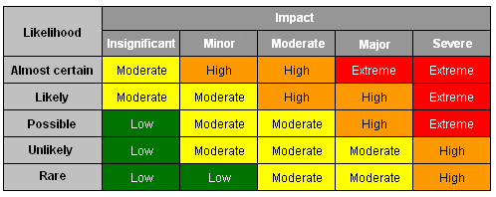
Risk Characteristics and Exposure
Probability (likelihood) of occurrence
Impact (consequence) of occurrence
Severity (risk exposure) = probability x impact
Use whatever scale you prefer, e.g.:
Probability (0-10, 0%-100%)
Impact (0-10, $ amount)
Example qualitative matrix

Slide 25
Attain Risk Exposure/Severity Matrix
Risk Severity = (probability of occurrence) x (impact of occurrence)
Attain’s quantitative matrix based on thresholds
Why quantitative over qualitative?

Slide 26
Presenting Risks
Qualitative (High, Medium, or Low)
Quantitative
H
H/L
H/H
Probability
M/L
M/M
M/H
L/L
L/H
L
Impact
H
Risk Event | Probability | Impact
1 | 10% | $500,000 overrun 10 week delay
2 | 50% | $100,000 overrun 16 week delay
3 | 75% | $10,000 overrun 2 week delay

Slide 27
Sample Risk Listing – Qualitative
Category | WBS # | Risk Event | Probability | Impact | Exposure | Priority Ranking
Customer | 1.2.1 | Customer fails to identify all requirements, causing development to be incomplete. | Low | Low | L/L | 3
Legal | 1.3.2 | Subcontractor employees not properly trained resulting in quality issues. | Medium | Medium | M/M | 2
Financial | 1.5 | COS may be substantially higher than planned, resulting in reduced gross margin. | High | High | H/H | 1

Slide 28
Sample Risk Listing – Quantitative
Category | WBS # | Risk Event | Probability | Impact | Exposure | Priority Ranking
Customer | 1.2.1 | Customer fails to identify all requirements, causing development to be incomplete. | 10% | $100 overrun | -$10 | 3
Financial | 1.5 | COS may be substantially higher than planned, resulting in reduced gross margin. | 80% | $5,000 reduced GM | -$4,000 | 1
Legal | 1.3.2 | Subcontractor employees not properly trained resulting in quality issues. | 50% | $1,000 rework | -$500 | 2

Slide 29
Attain Risk Thresholds
Risk Thresholds

Slide 30
Determine Risk Response Strategy
Document outputs of risk analysis activities:
Risk triggers
Indicators that a trigger is imminent
Appropriate risk response strategy
Work down the prioritized list; evaluate and select a response; and incorporate options into the project plan
Ask questions
How can the risk event be avoided?
What does it mean to accept the risk?
If we transfer the risk, who does it go to and is that a feasible option?

Slide 31
Risk Response Strategies
Acceptance (accepting the consequences – do nothing, or have a contingency plan)
Control (reducing the expected value of the threat)
Minimizing the probability of risk occurrence (first)
Minimizing the impact of the risk should it occur (second)
Transference (passing the threat to a third party – e.g., subcontract, warranty, insurance)
Avoidance (eliminating a specific threat – e.g., accomplish the work package, take an alternative approach)
Monitor – used to observe a risk that may become obsolete/inactive or overcome by events

Slide 32
Risk Response Examples
Risk Event | Potential Response Plans | Strategy
Customer fails to identify all requirements, causing development to be incomplete. | Work with customer before contract award to ensure sufficient level of requirements detail | Control (Reduce Probability)
 | Include contractual clause requiring customer clarification of requirements, with penalties for noncompliance | Control (Reduce Impact); Transference
New personnel unavailable due to recruiting/staffing delays causes delay in prototype validation. | Schedule existing personnel to work overtime to ensure completion on time | Control (Reduce Impact)
 | Extend overall project completion date | Acceptance
 | Perform prototype validation using automated software tool instead of personnel. | Avoidance (Alternative approach)
Not every response strategy is “control”

Slide 33
Exercise 2 – Develop Risk Response Plan and Strategy

Slide 34
Execute, Evaluate, Document
Execute the RM plan/strategies
Carry out risk management plan as part of project execution
Include risk reviews in the agenda for regularly held project status meetings:
Progress made in risk management plan
Risk areas and descriptions
New problems observed or anticipated
Management action required
Evaluate Results
Identify improvements to the overall RM process
Evaluate the effectiveness of response strategies – did they work?
Continuously document risks throughout the project life cycle
Improve your process and guidelines

Slide 35


Determine Contingency Plans
Draft contingency plans for high priority risks, as appropriate.
Required for critical risks at a minimum.
Accepted risks do not require contingency plans.
Contingency Plans – PM needs to understand the financial impact of risk events, should they occur, and build in necessary reserves.
Mark N/A as appropriate in the log; leave no field blank!

Slide 36
In-Process Review (IPR) Methodology

Slide 37
IPR Methodology
Holistic risk-based management approach
Improves delivery excellence in support of our customers
Provides consistent engagement delivery standards and expectations across Attain programs
Supports successful project execution and delivery (manage the business)
Focuses on proactive and expeditious discovery of potential and perceived issues; ensures action is taken to avoid, recover from, or minimize risk / issue impact
Monitors client satisfaction and enhances client relationships (grow the business)
A “sounding board” in which the PMs elicit feedback, ideas, and support for successful project execution
Facilitates team cadence and Attain DNA (strategic intent)

Slide 38
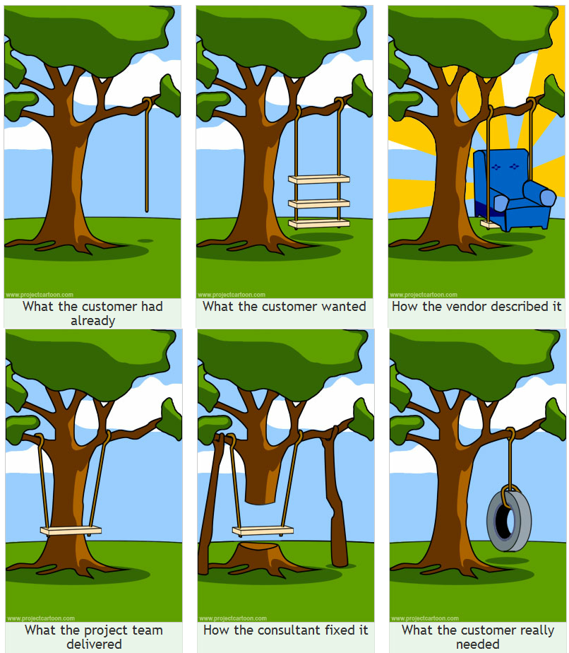
Why do we need this framework?

Slide 39
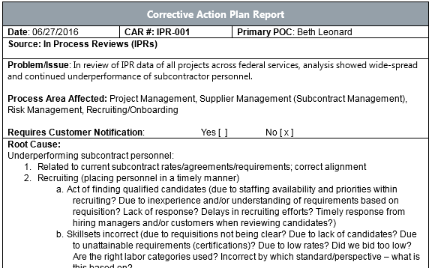
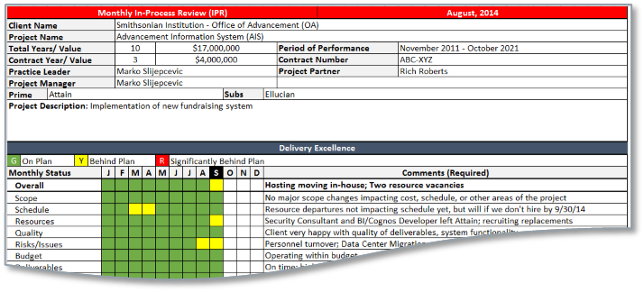
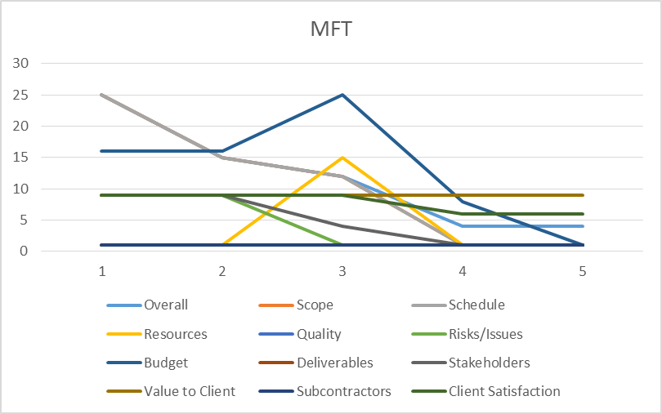
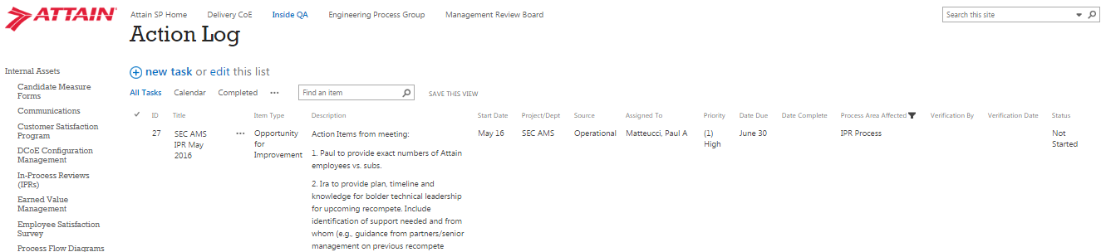
In-Process Review (IPR) Methodology Cont’d
Perform Quantitative and Root Cause Analysis
Quantitative improvements for metrics-based reporting and root cause analysis
Use 5-why methodology for root cause
Document and report results; project roll up and organization roll up
Obtain buy-in from executive management; data-driven decision making!

Slide 40
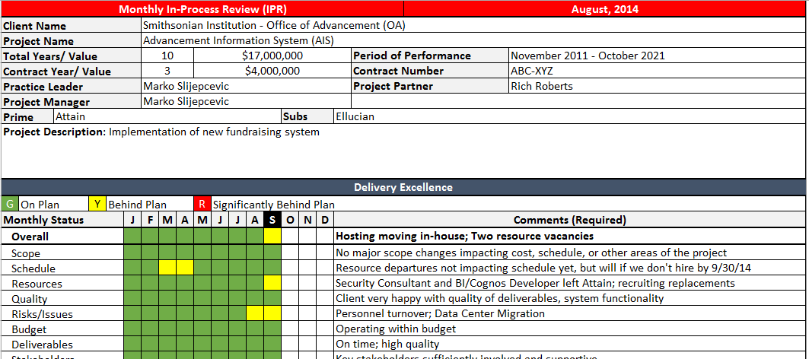
Monthly IPR Template
Refer to Template
Use the correct version! (Delivery Center of Excellence – SharePoint)
Provide to Delivery Excellence each month
Perform peer reviews

Slide 41
Exercise 4A – IPR

Slide 42
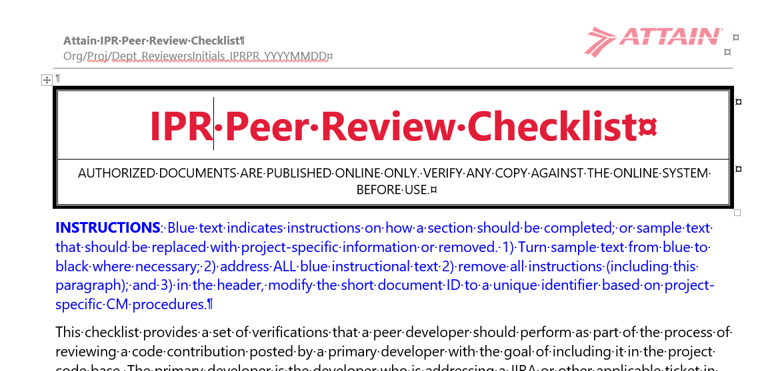
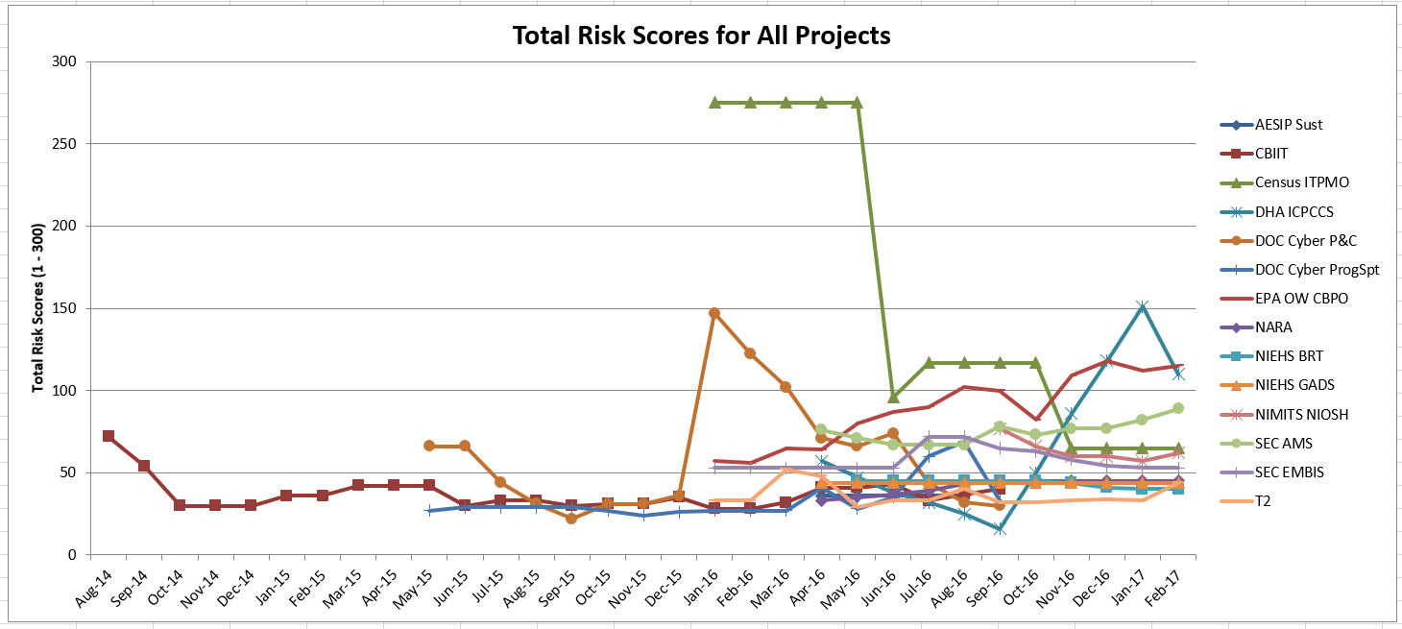
Peer Reviews of IPRs
Perform Monthly Reviews
Perform Monthly Peer Reviews (Minimum: Risk Sections)
Planned vs. Actual Risk Values
Probability x Impact=Severity
5x5 Matrix = Maximum 300 points
Root cause(s) identified
Corrective actions identified and tracked to closure
Collect metrics
Document outcomes

Slide 43
Customer Satisfaction – Why bother?
Value of the Program to You and Your Customer
Better understanding of your customer’s value perception
Customer-focused changes
Stay competitive
Secure new business
Ensure successful delivery of quality products and services
Reduce risks
Increase customer satisfaction
Increase employee satisfaction

Slide 44
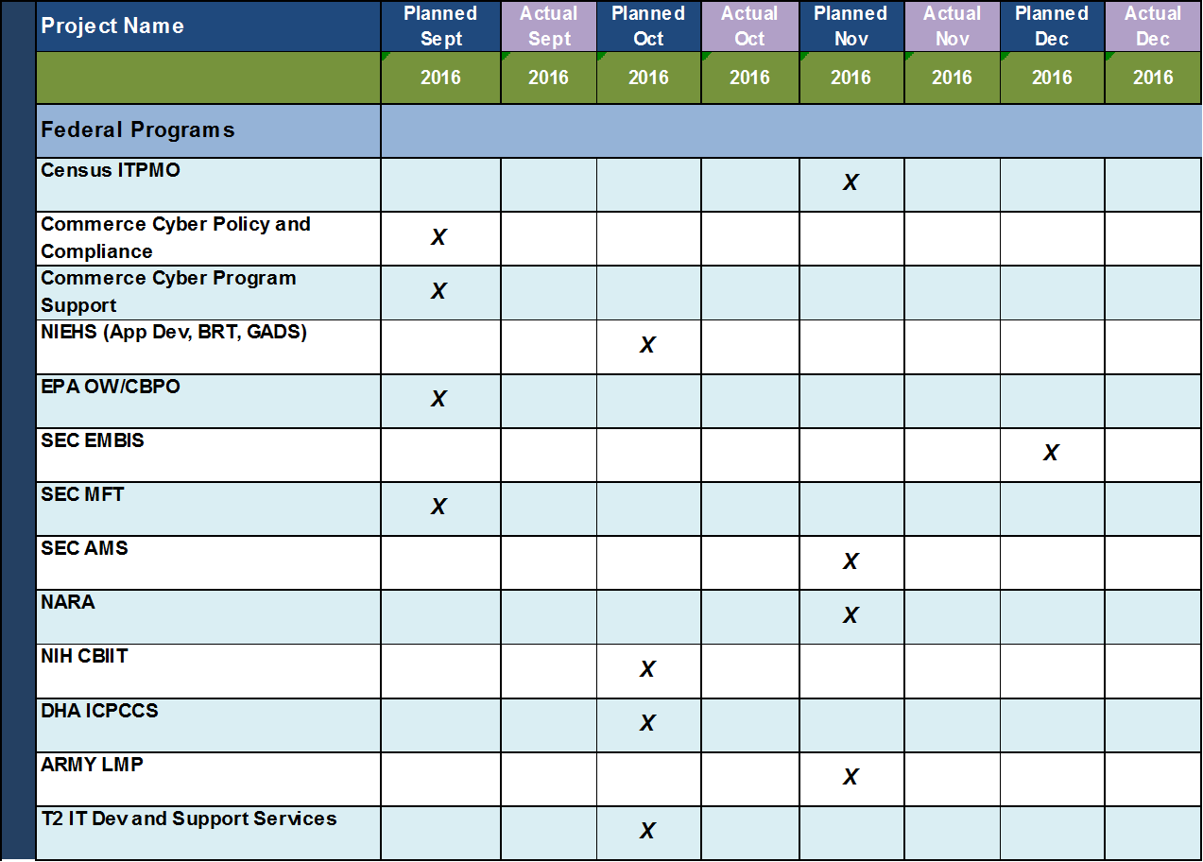
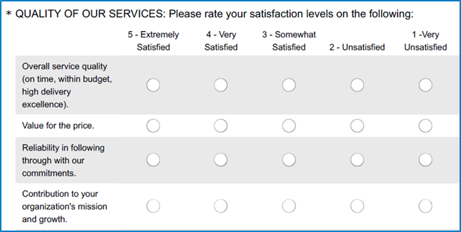
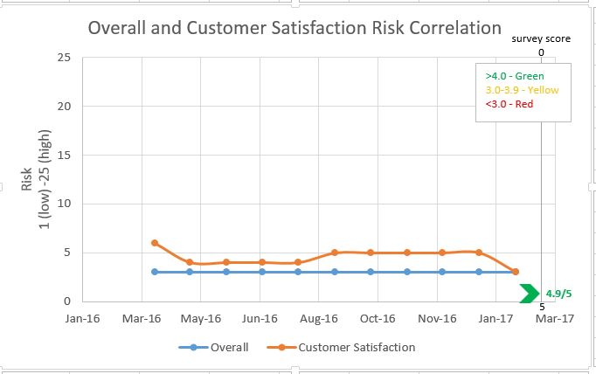
Customer Satisfaction Program
GOAL: >4.0 on 1-5 Rated Scale
Schedule initial face-to-face customer meeting; set the expectations
Unbiased third party; “sounding board” for your customer; align to your IPRs
Thresholds/results determine further actions needed (e.g., quality assessments); “The Sweet Spot”
New projects: baseline survey NLT 2-3 months from start
Ongoing: per customer typically 3-6 months

Slide 45
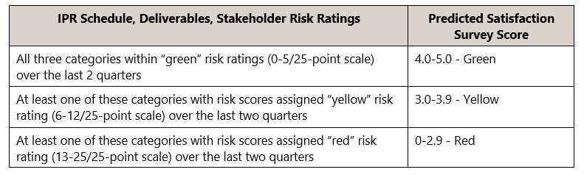
Using IPR Risk to Predict Customer Satisfaction
Performance Models
Predicted Factors:
Schedule
Deliverables
Value to the Client
Risk Factors = 300 points; overall risk is averaged

Slide 46
The Sweet Spot!
Performance model for predictive analysis
The Sweet Spot! Risk factors a prediction of customer satisfaction
Achieving
Delivery Excellence and Finance validating financials monthly
Completing IPR risk data monthly
Obtaining independent customer satisfaction input
Maintaining
Quarterly IPRs
Performing peer reviews
IPR action items: https://attain2014.sharepoint.com/DCOE/IQA/Lists/ActionItems/IPR%20Actions.aspx
Correcting
Separate risk review meetings based on:
Risk scores >100 pts AND customer satisfaction scores <4.0
OR customer satisfaction score <3.8
OR risk scores >150 trended 2-3 months
Corrective action plans

Slide 47
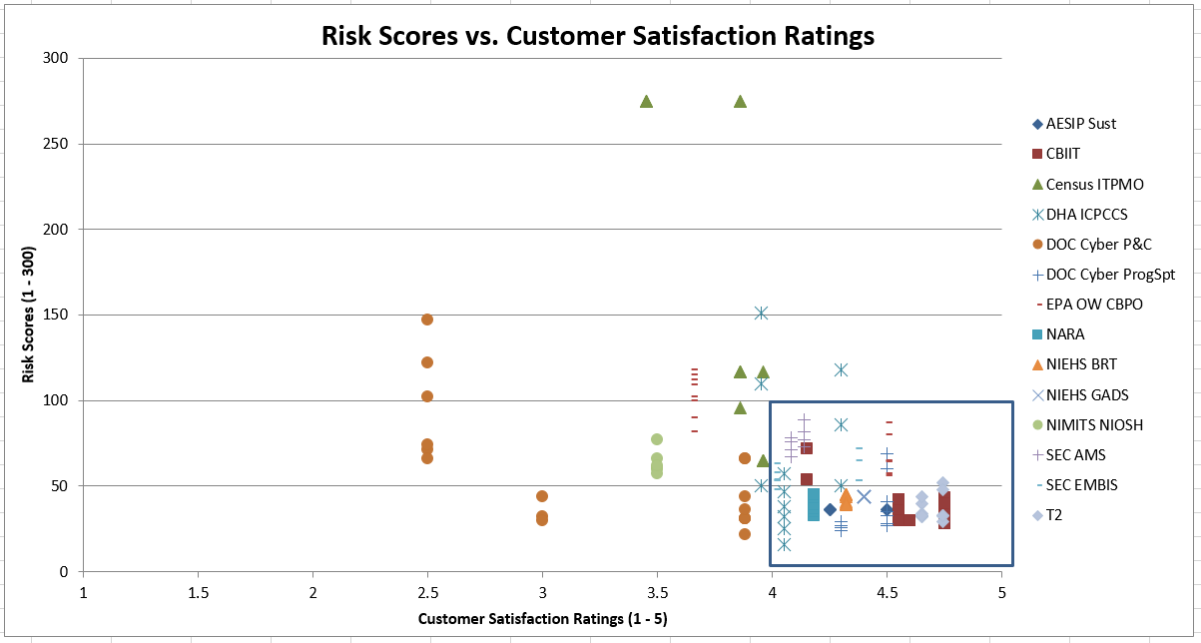
The Sweet Spot
Risk vs. Customer Satisfaction
The Sweet Spot!

Slide 48
IPR In-depth Risk Assessment and Corrective Action
Green Project – Steady-State
Overall IPR Risk <100 points
Customer Satisfaction Survey Complete and >4.0
All three predictors green
Continue Quarterly IPRs with IPR Board
Provide IPRs monthly to Delivery Excellence
Ongoing Internal Team Meetings
Customer Satisfaction Surveys (every 3-6 months)
Corrective Action Plan (as needed)

Slide 49

IPR In-depth Risk Assessment and Corrective Action
Yellow Project – Increased Risk
Overall IPR Risk Between 100 – 200 points
Customer Satisfaction Survey Complete and >3.8
Any of the three predictors yellow 2 months or more
Continue Quarterly IPRs with IPR Board
Provide IPRs monthly to Delivery Excellence
Ongoing Internal Team Meetings
Customer Satisfaction Surveys (increased frequency)
Corrective Action Plan (REQUIRED); monitored by partner/senior management

Slide 50

IPR In-depth Risk Assessment and Corrective Action
Red Project – Increased Risk
Overall IPR Risk >150 points for 2 quarters in a row
Customer Satisfaction Survey Complete and <3.8
Any of the three predictors yellow 2 quarters or more
Any of the three predictors red for any period
Continue Quarterly IPRs with IPR Board
Provide IPRs monthly to Delivery Excellence
Ongoing Internal Team Meetings
Executive Customer Satisfaction Meetings (weekly)
Quality Assessment (REQUIRED)
Corrective Action Plan (REQUIRED); presented to and monitored by IPR board

Slide 51


Monitor and Control Risks
Provide timely risk status to stakeholders
Facilitate effective and strategically aligned decision making
Document risk management communication and reporting frequency in the risk management plan (or PMP)
Continuously review and update the risk log

Slide 52
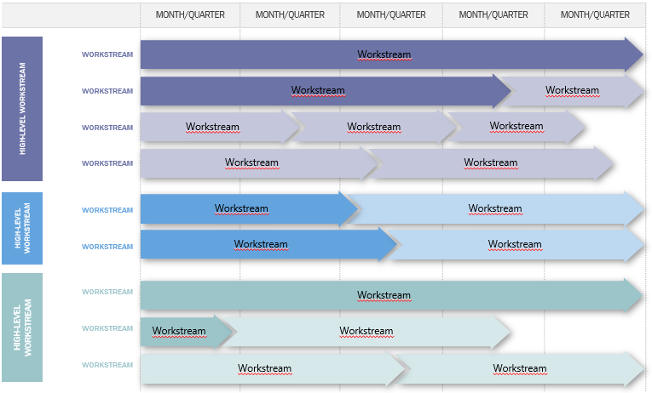
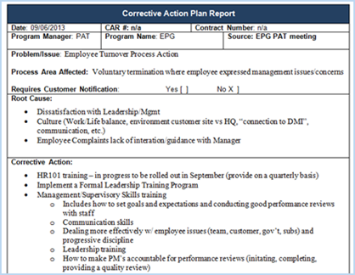
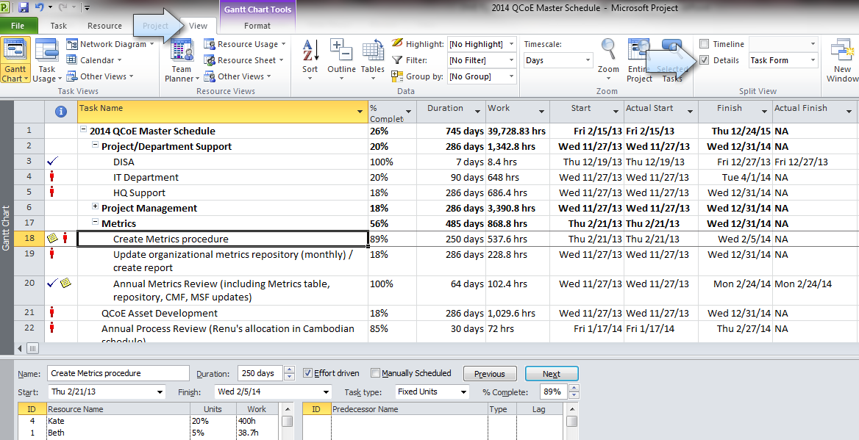
Corrective Action / Issue Management
Ongoing and related to increased or realized risks
Perform proactive/reactive QA assessments
On site with customer/team
Interview all stakeholders
Review work processes and products
Identify strengths
Identify weaknesses
Provide recommendations for improvement (corrective/preventive)
Provide action plan/roadmap
Facilitate and monitor corrective/preventive actions
Proposal support

Slide 53


Store Documentation in the CM Repository
Store risk documentation in project’s CM repository (e.g., RMP, Risk Log, etc.)
QA personnel ensures risk documentation is uploaded to project CM repository by project CM manager (or designee)

Slide 54
Resources
Delivery Center of Excellence:
https://attain2014.sharepoint.com/DCOE/SitePages/Home.aspx
CMMI Overview:
http://cmmiinstitute.com/
CMMI-DEV:
http://cmmiinstitute.com/cmmi-solutions/cmmi-for-development/
Beth Leonard
Phone: 703-857-2260
deleonard@attain.com

Slide 55
Questions?

